Slide 1

AI-Assisted Farming For Crop Recommendation & Farm Yield Prediction Application

Slide 2

01.
Agriculture Scenario
Agriculture is a support for most people in every countryand will never be under estimated.
In agricultural conditions such as rain, temperature and humidity play an important role in agricultural life. Deforestation and pollution are causing climate
change, so it is difficult for farmers to make decisions on soil preparation, seeding, and
harvesting. According to the Census of Agriculture, the total number of participants was
138.35 million with an average size of 1.15 hectares. Of the total catch, 85 percent in the low-lying and low-income farm sectors are less than 2 hactare.
Low credit availability and the prominent role of informal lenders affect farmers' decisions in purchasing inputs and outbound sales. Poor farming base that makes climate reliability, marketing, and supply chain suitable for high-value crops.
Despite all these facts, the average production of many plants in India is meager.
The people of the country in the next ten years are expected to be the largest in the
world and providing them with food will be the most important thing. Farmers have not
yet been able to earn decent wages.

Slide 3
01.
AI and ML in Agriculture
The recent global epidemic has highlighted the importance of the connection between food and goods. What we once thought was ‘infinite’ could quickly turn into very short when it comes to chain sales.Fortunately, ML and AI change outdated ways of planning and predicting to intelligent ways. By adapting the predictions, AI and ML can reduce anxiety when it comes to food security.
Advantages:
➤ Improved forecasting and planning with machine learning.
➤ Increased productivity and yield in AI-enabled farming and food preparation.
➤ Greater food safety in storage, compliance and auditing.
➤ Analyzing and optimizing soil.
➤ Breeding specific plant species.
➤ Detecting and preventing disease and weeds.
➤ Managing irrigation.
➤ Precision agriculture
The implementation of this AI and ML technology has transformed the complete journey of food, with some huge benefits.AI in agriculture is redefining the conventional pattern of agriculture. The future of AI and ML in agriculture is becoming progressive in developing comprehensive transformation with different advanced strategies.

Slide 4
Our Purpose and Solution
To help farmers in downplay the risk of agriculture, we propose creating a
solution that recommends the farmers about the best crops to be cultivated based on
climatic parameters and also predicts the yield and revenue that would be generated for
cultivated land. We use IBM Services to build Machine Learning models and integrate
them with a User Interface for inputs.

Slide 5
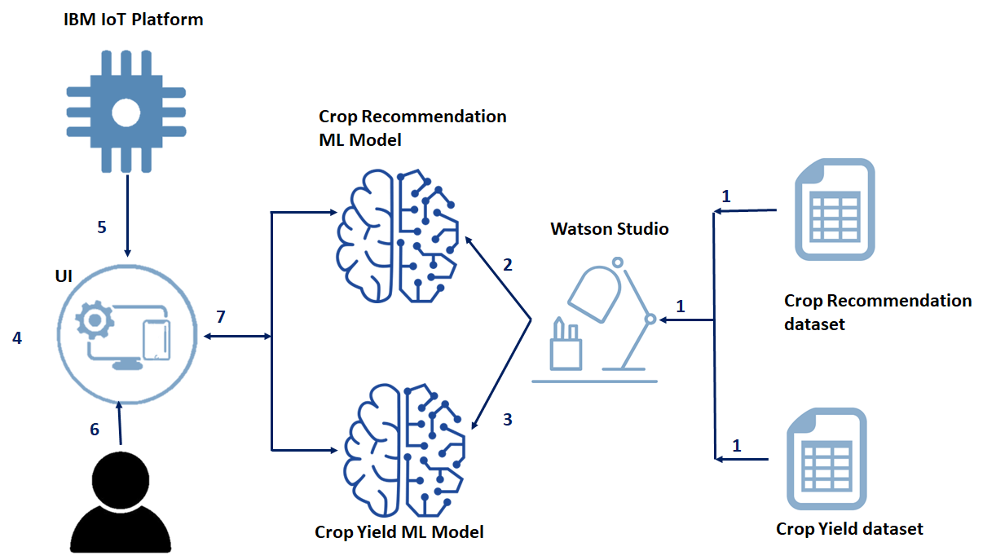

Slide 6
Thank YOU

